Slide 1
Lecture 21: Intro to Frequency Response
Review of time response techniques
Intro to the concept of frequency response
Intro to Bode plots and their construction

Slide 2
Time Response Review
Previously, we have determined the time response of linear systems to arbitrary inputs and initial conditions
We have also studied the character of certain standard systems to certain simple inputs
Used algebra and root locus to place dominant closed-loop poles to give desired time response
τ, M_{p}, t_{p}, t_{s}, t_{r}, etc.
SYSTEM

Slide 3
Time Response Review
Advantage of pole-placement approach is that the time response can be affected directly, easiest for canonical systems
Disadvantage of the approach is that sometimes it is difficult to determine the effect of higher-order poles and of zeros, and how the system will respond to complex inputs

Slide 4
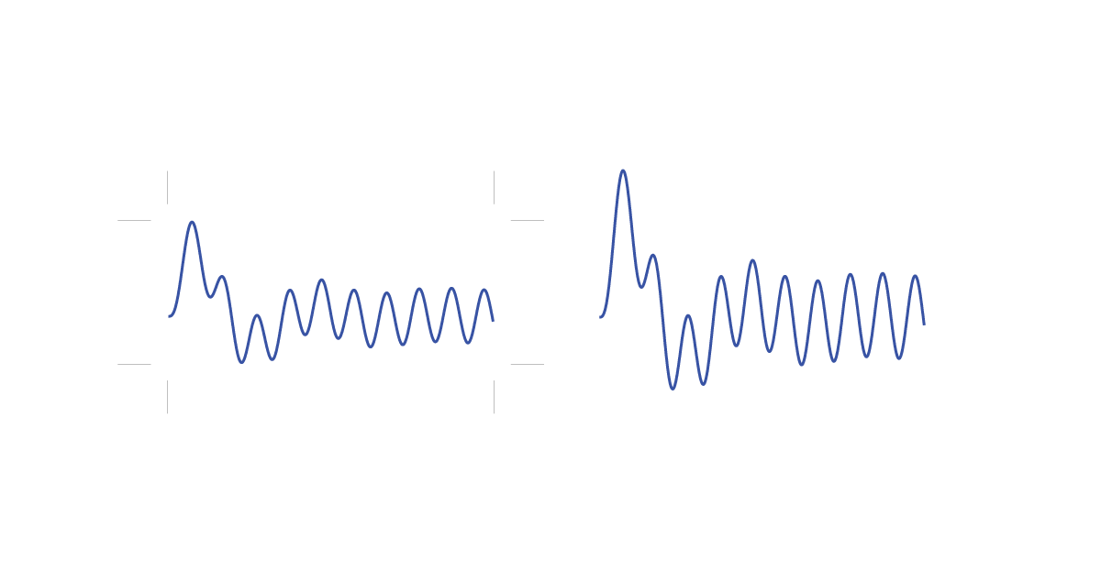
Frequency Response Concept
Input sine waves of different frequencies and look at the output in steady state
If G(s) is linear and stable, a sinusoidal input will generate in steady state a scaled and shifted sinusoidal output of the same frequency
G(s)

Slide 5
Frequency Response Concept
Two primary quantities of interest that have implications for system performance are:
The scaling
The phase shift
Important for designing controllers, filters, choosing sensors, designing mechanical systems, etc.
= magnitude of G at s=jω
= angle of G at s=jω

Slide 6
Frequency Response Analysis
Attenuation may be
desired: noise, disturbances
undesired: commanded reference input
Amplification can destabilize a system (resonance)
Phase lag means information is delayed, can hurt performance and also destabilize a system

Slide 7
Frequency Response Concept
Different ways to present this information:
Bode diagram (two graphs)
magnitude vs. frequency
phase vs. frequency
Nyquist plot
magnitude vs. phase (polar)
Nichols chart
magnitude vs. phase (rectangular)

Slide 8
Bode Diagram Example
Magnitude in decibels vs. frequency in rad/sec
Phase in degrees vs. frequency in rad/sec

Slide 9
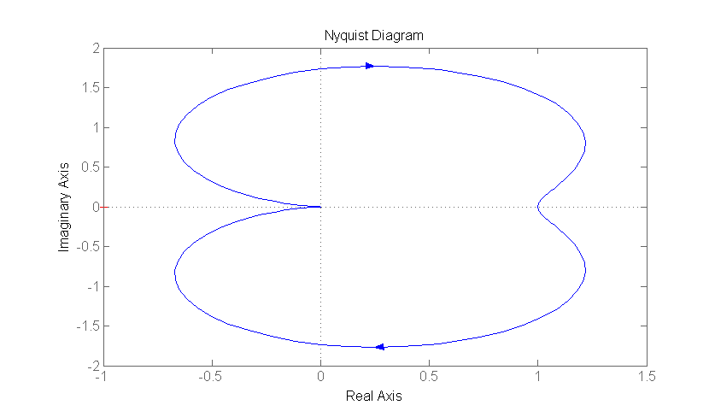
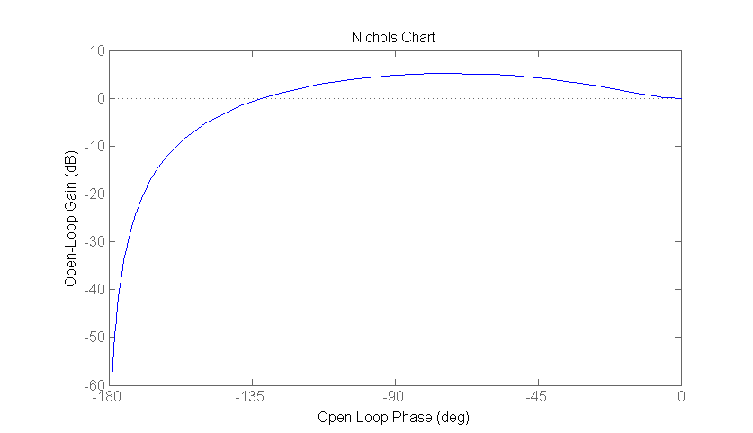
Other Examples
Nyquist plot
Nichols chart

Slide 10
How to Plot a Bode Diagram
Approach #1: Point by Point
Substitute s=jω into G(s) and calculate magnitude and phase for a series of different frequencies ω
where

Slide 11
How to Plot a Bode Diagram
Approach #2: Use asymptotic approximations
Plot straight-line approx of components, then add
Ex.
can add Bode plots because of mathematical props

Slide 12
How to Plot a Bode Diagram
Need a library of components
Constant gain (K)
M(dB)
ω(rad/sec)
φ(deg)
ω(rad/sec)

Slide 13
How to Plot a Bode Diagram
2. Differentiator (s)
M(dB)
ω(rad/sec)
φ(deg)
ω(rad/sec)

Slide 14
How to Plot a Bode Diagram
3. Integrator (1/s)
M(dB)
ω(rad/sec)
φ(deg)
ω(rad/sec)

Slide 15
How to Plot a Bode Diagram
4. Simple zero (Ts+1)
M(dB)
ω(rad/sec)
φ(deg)
ω(rad/sec)

Slide 16
How to Plot a Bode Diagram
5. Simple pole (1/(Ts+1))
M(dB)
ω(rad/sec)
φ(deg)
ω(rad/sec)

Slide 17
How to Plot a Bode Diagram
Will do complex poles and zeros later (2nd order)
Approach #2:
Put into Bode form
Sketch straight line approximations
Add graphs
Try to approximate curves

Slide 18
Example
Sketch Bode diagram for
Put into Bode form
Sketch components
a
b
c

Slide 19
Example (continued)
M(dB)
φ(deg)
M(dB)
φ(deg)

Slide 20
Sketch Requirements
Make sure to include the following elements in your hand sketches of Bode diagrams
Magnitude plot
Phase plot
Frequency where slope changes
Slope of each line segment
Magnitude of at least one frequency
Frequency where slope changes
Do not need to identify slopes, but magnitudes must be relative
Limiting phase as frequency goes to zero and infinity

